Slide 1
MODULE 07: AIRWAY MANAGEMENT
TCCC TIER 1
All Service Members
TCCC TIER 2
Combat Lifesaver
TCCC TIER 3
Combat Medic/Corpsman
TCCC TIER 4
Combat Paramedic/Provider

Slide 2
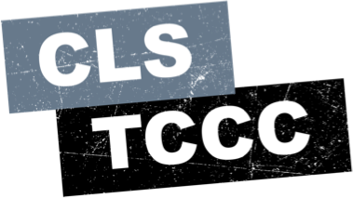




TACTICAL COMBAT CASUALTY CARE (TCCC) ROLE-BASED TRAINING SPECTRUM
ROLE 1 CARE
NONMEDICAL PERSONNEL
MEDICAL PERSONNEL
ASM
CMC
CPP
CLS
YOU ARE HERE
STANDARDIZED JOINT CURRICULUM
2

Slide 3





TERMINAL LEARNING OBJECTIVE
STUDENT LEARNING OBJECTIVES
Given a combat or noncombat scenario, perform airway management during Tactical Field Care in accordance with CoTCCC Guidelines
08
Identify signs of an airway obstruction
Demonstrate opening the airway with the head-tilt chin-lift or jaw-thrust maneuver
Demonstrate the placement of a casualty in the recovery position in Tactical Field Care
Demonstrate the insertion of a nasopharyngeal airway (NPA) into a casualty in Tactical Field Care
Describe the technique for ventilating a casualty with a bag valve mask (BVM) in Tactical Field Care
5
ENABLING LEARNING OBJECTIVE (ELO)
= Cognitive ELOs
= Performance ELOs
3

Slide 4
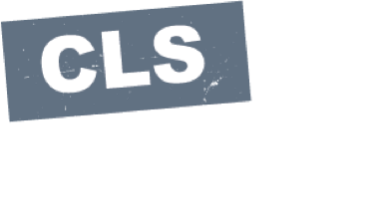

MARCH PAWS
TACTICAL FIELD CARE
DURING LIFE-THREATENING
AFTER LIFE-THREATENING
M A R C H
MASSIVE BLEEDING #1 Priority
P
PAIN
AIRWAY
A
ANTIBIOTICS
R RESPIRATION (breathing)
C CIRCULATION
_{H} HYPOTHERMIA/ HEAD INJURIES
W
WOUNDS
S
SPLINTING
4

Slide 5
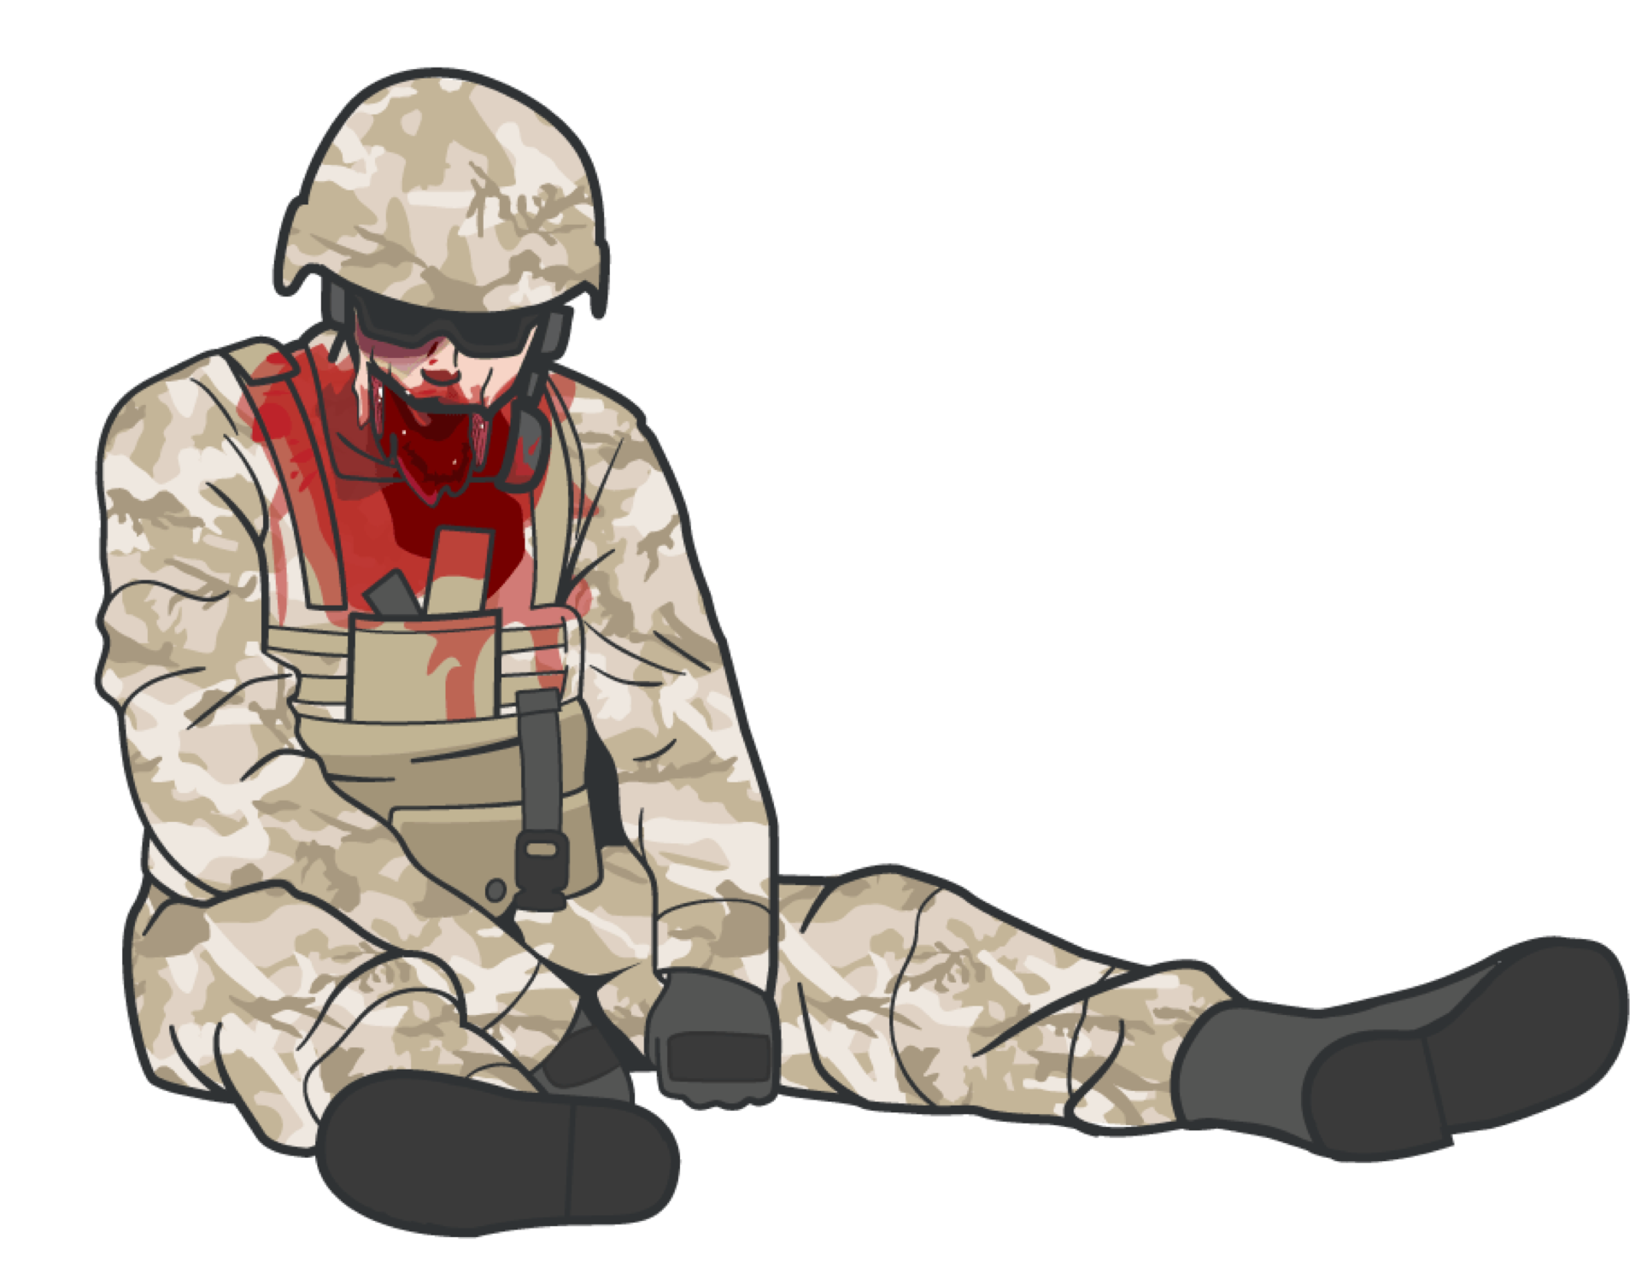
AIRWAY
AIRWAY MANAGEMENT
Airway obstruction on the battlefield is often due to maxillofacial trauma
If the casualty is breathing on their own but unconscious or semi- conscious, and there is no airway obstruction, further airway management is achieved through a Nasopharyngeal Airway (NPA)
Unconscious casualties can also lose their airway as the muscles of their tongue may have relaxed, causing the tongue to block the airway by sliding to the back of the mouth and covering the opening to the windpipe
5

Slide 6
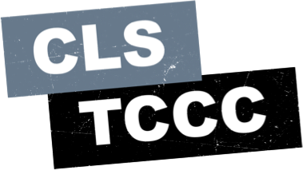

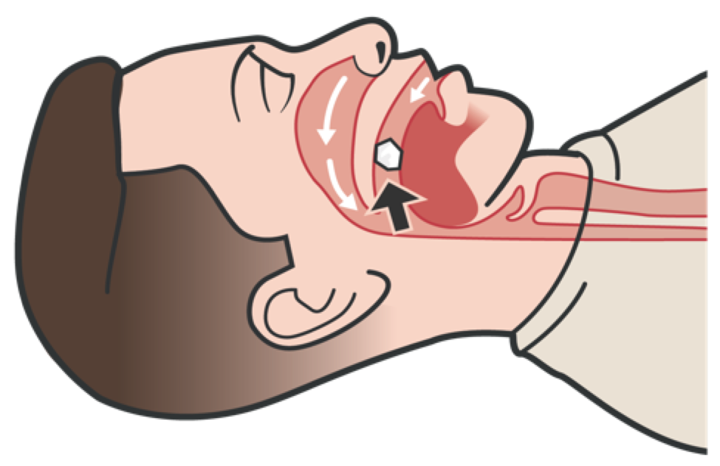
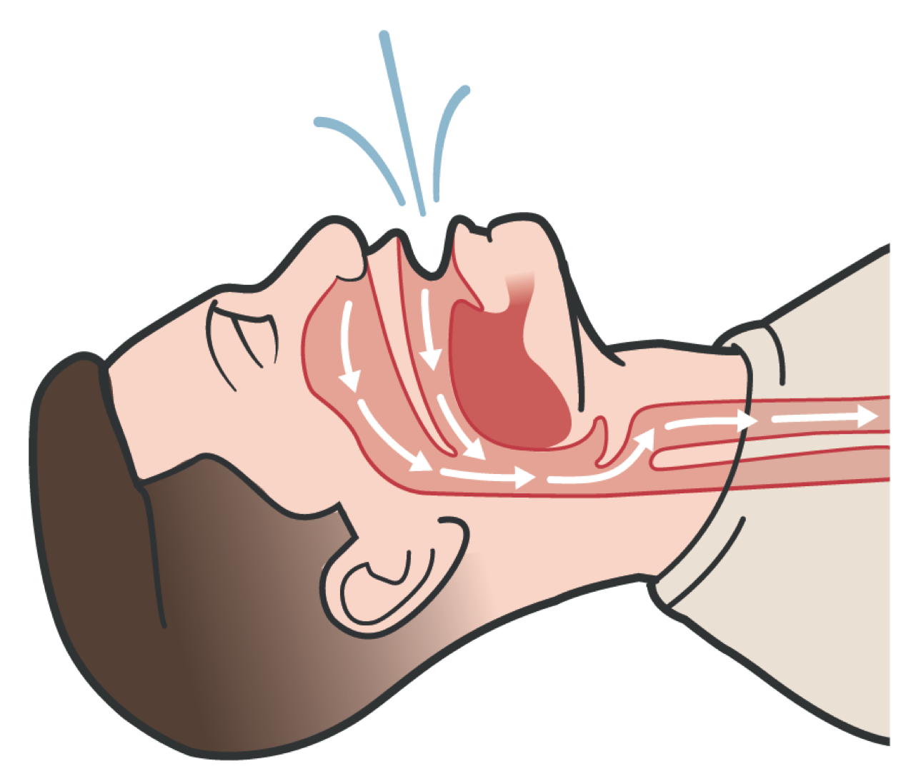

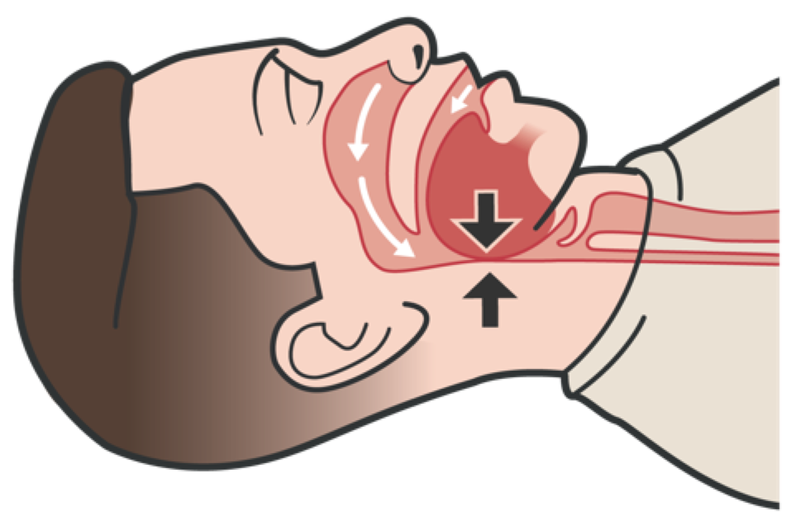


IDENTIFYING OBSTRUCTED AIRWAY
IDENTIFYING AN OBSTRUCTED AIRWAY
SIGNS AND SYMPTOMS AIRWAY MAY BE BLOCKED:
Casualty is in distress and indicates they can’t breathe properly; casualty is making snoring or gurgling sounds
Visible blood or foreign objects are present in the airway
Maxillofacial trauma (severe trauma to the face) is observed
IMPORTANT! Remove any visible objects obstructing the airway, but do not perform a blind finger sweep
M A R C H
#TCCC-CLS-PPT-07 30 JUN 20
6

Slide 7

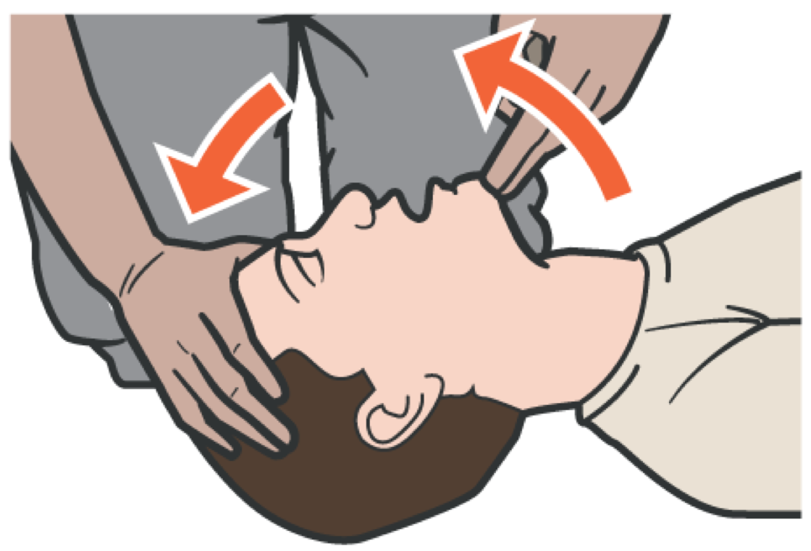
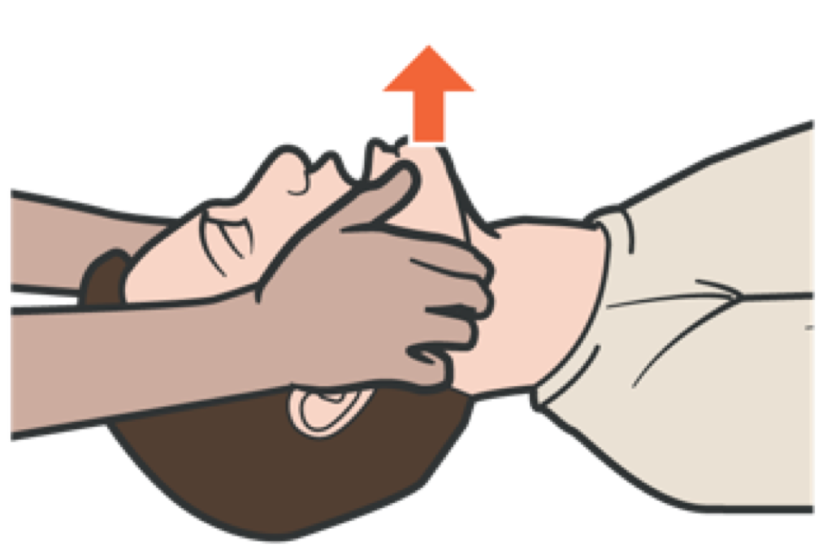

IN A CASUALTY WITHOUT A FOREIGN BODY AIRWAY OBSTRUCTION, YOU CAN PERFORM THE FOLLOWING MANEUVERS:
OPENING THE AIRWAY
HEAD-TILT CHIN-LIFT JAW-THRUST
Unconscious casualty's tongue may have relaxed, causing their tongue to BLOCK the airway by sliding to the back of the mouth and covering the opening to the windpipe
If you suspect that the casualty has suffered a neck or spinal injury, use the jaw-thrust method
M A R C H

Slide 8

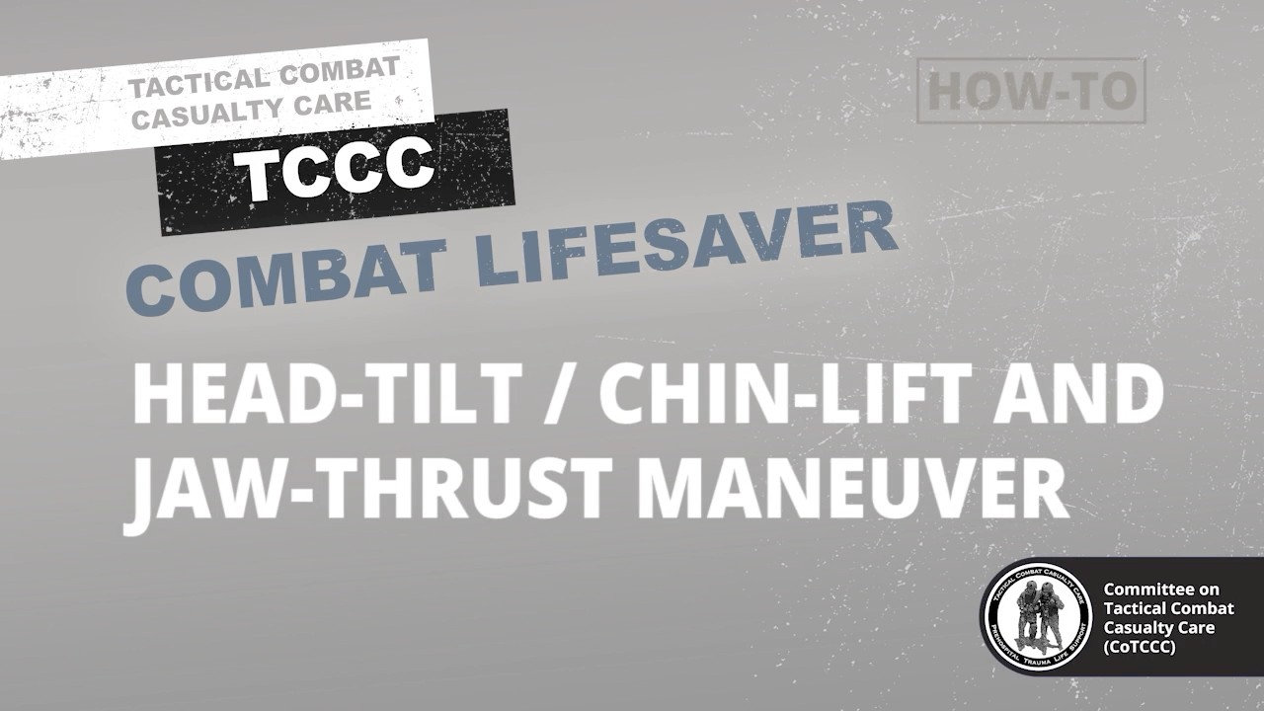
AIRWAY MANAGEMENT
HEAD-TILT/CHIN-LIFT AND JAW-THRUST MANEUVER
Video can be found on DeployedMedicine.com

Slide 9
SKILL STATION
Airway (Skills)
Head-Tilt/Chin-Lift Jaw-Thrust Maneuver

Slide 10
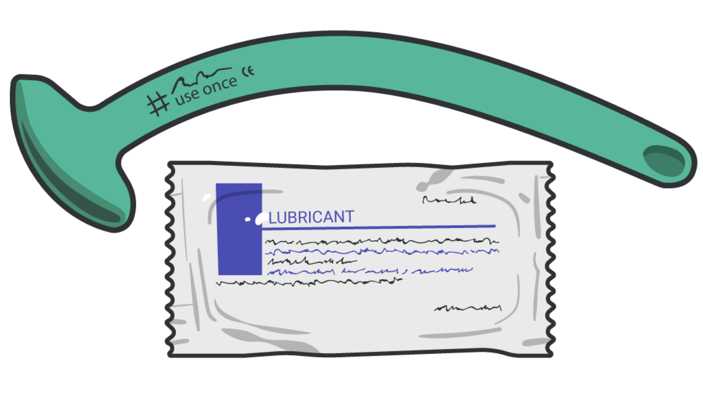

MANAGING THE AIRWAY
OPENING THE AIRWAY
IF the casualty is breathing on their own but unconscious or semi-conscious AND there is no airway obstruction, further airway management is best achieved with a Nasopharyngeal Airway (NPA)
An NPA can be used on a conscious or unconscious casualty to help open/maintain an airway
M A R C H
DO NOT attempt to insert an NPA if there is clear fluid coming from the nose or ears. This may be cerebrospinal fluid (CSF) and may be an indication of possible skull fracture.

Slide 11
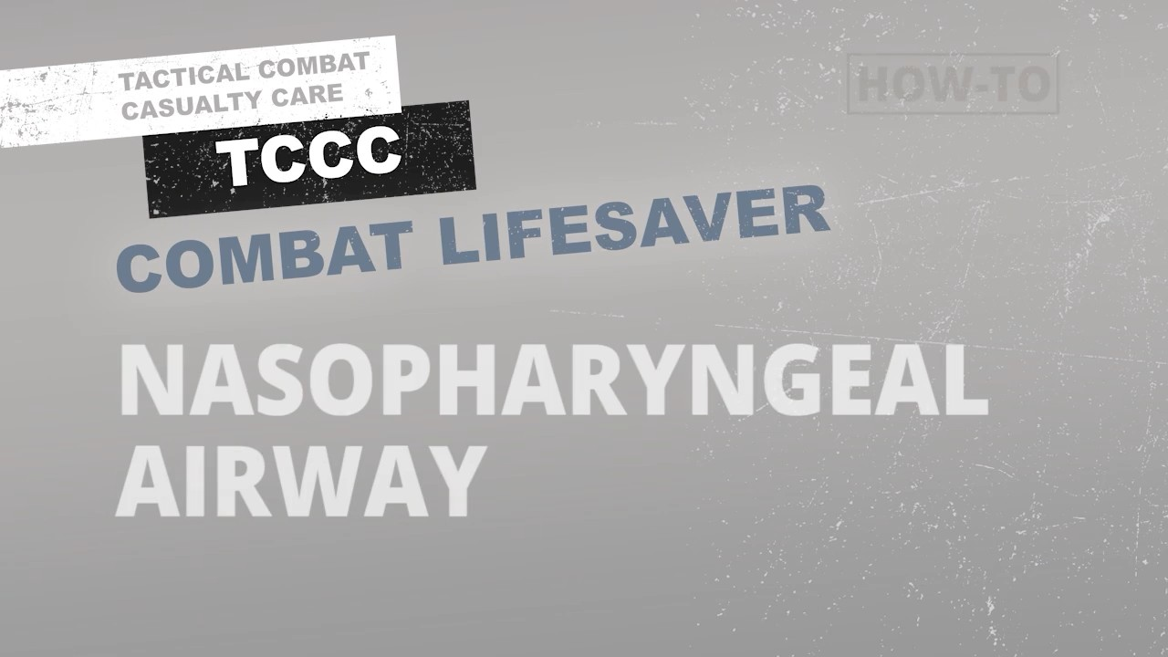
AIRWAY MANAGEMENT
NPA HOW-TO VIDEO

Slide 12
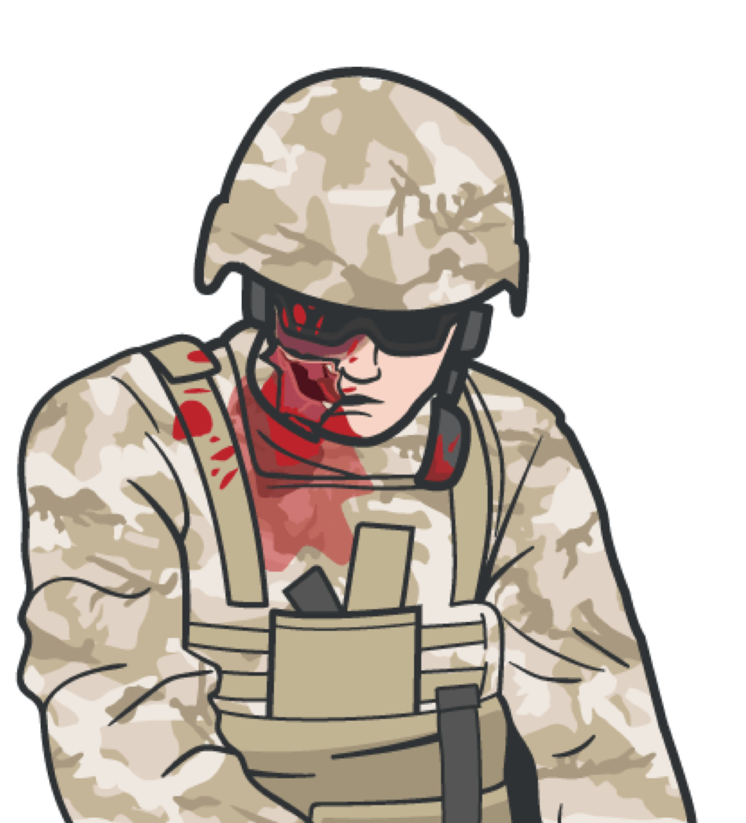
MAINTAINING THE AIRWAY
CASUALTY POSITIONING
If a casualty can breathe on their own, let them assume the best position that allows them to breathe, including sitting up
If a casualty can breathe on their own in a position of choice, DO NOT force them into a position or perform airway procedures that causes them difficulties in breathing

Slide 13
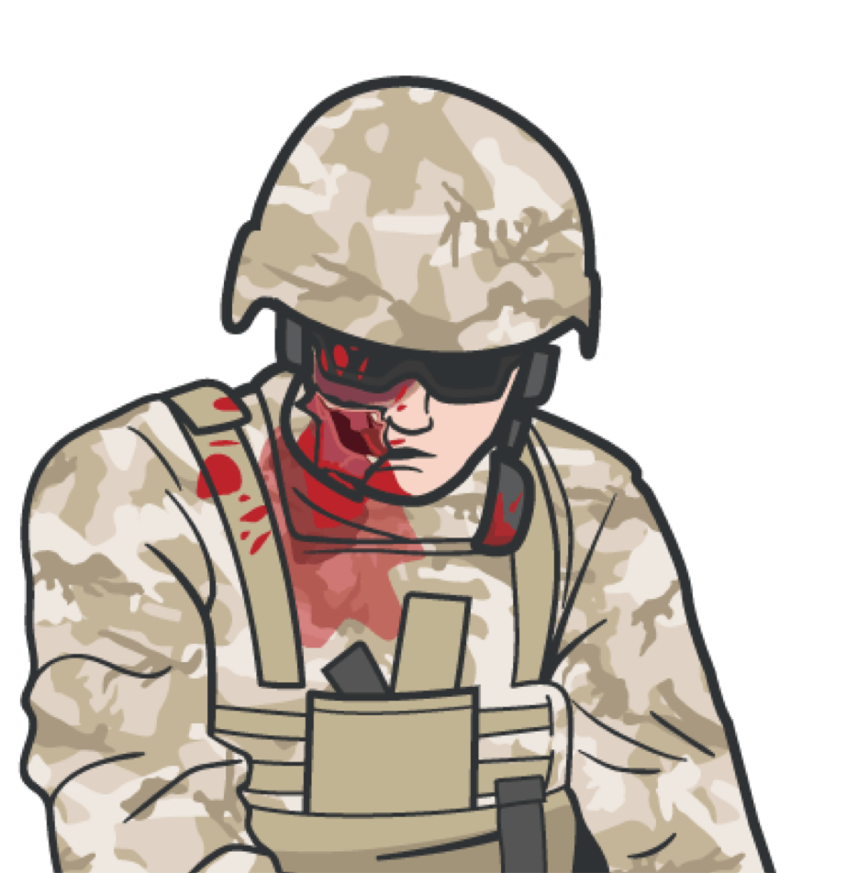
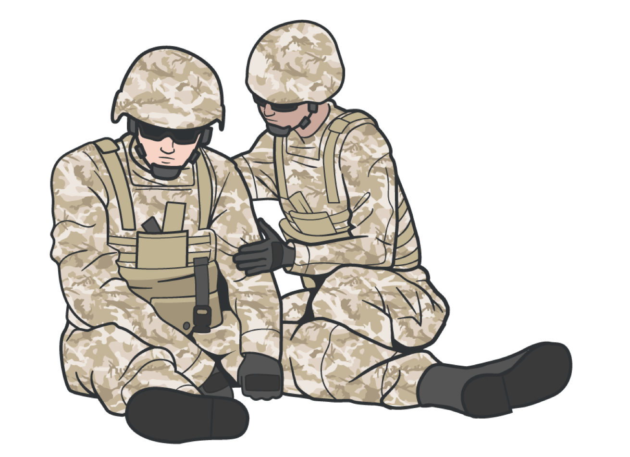
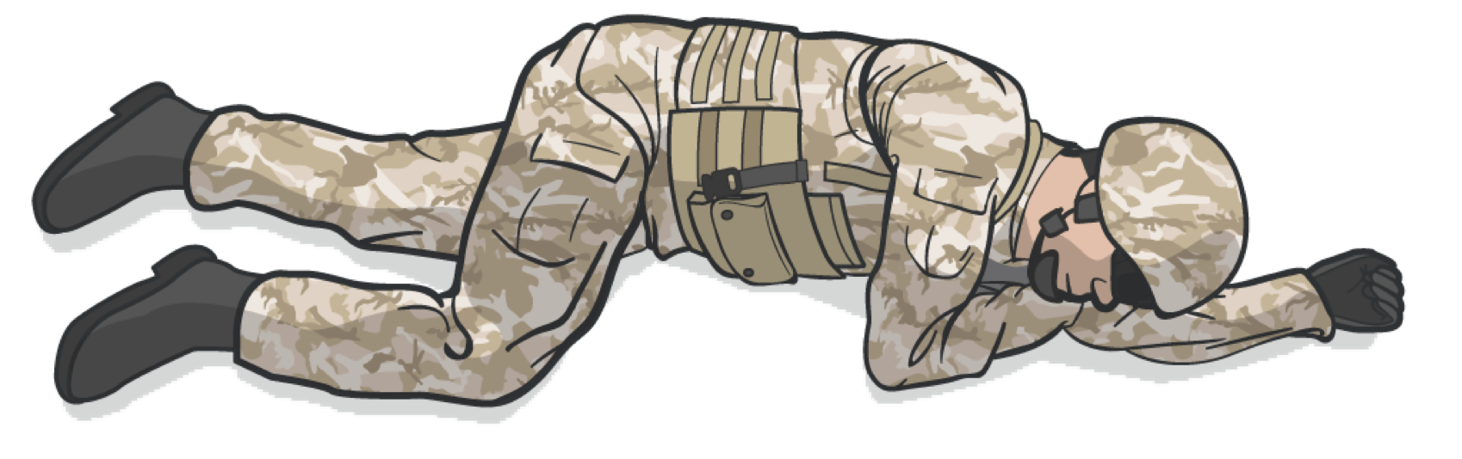
MAINTAINING THE AIRWAY/RECOVERY POSITION
MANAGING THE AIRWAY
Casualties with severe facial injuries can often protect their own airways by sitting up and leaning forward
Assist a conscious casualty by helping them assume any position that allows them to breathe easily, including sitting up
For an unconscious casualty not in shock, place them into the RECOVERY POSITION
M A R C H

Slide 14
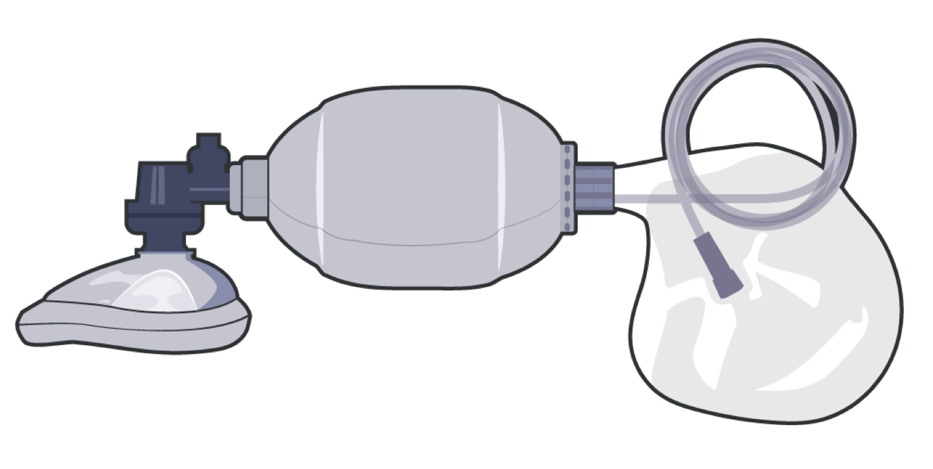
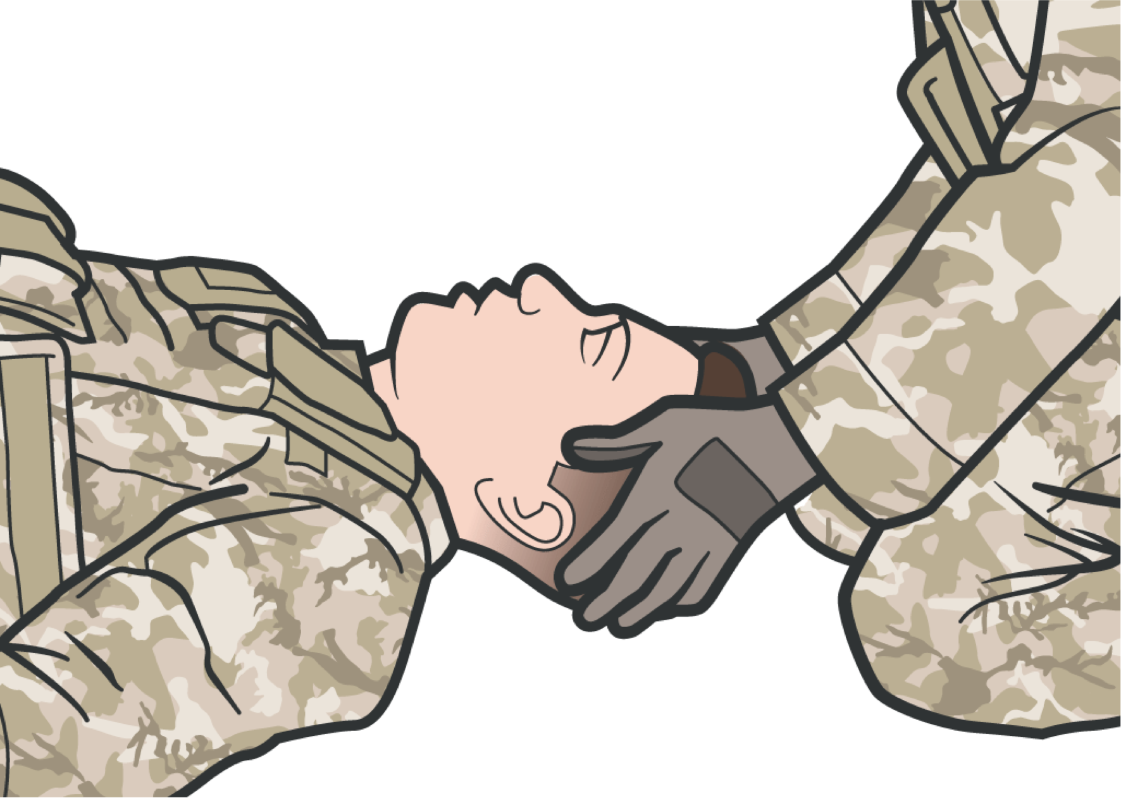
CASUALTY UNABLE TO BREATHE ON THEIR OWN
Medical personnel may ask you to assist them in ventilating a patient using a bag valve mask (BVM)
If respirations are noted to be reduced, provide ventilator support with BVM ventilations
A BVM is a device that can assist a casualty with breathing (ventilation) if they are NOT breathing adequately on their own

Slide 15
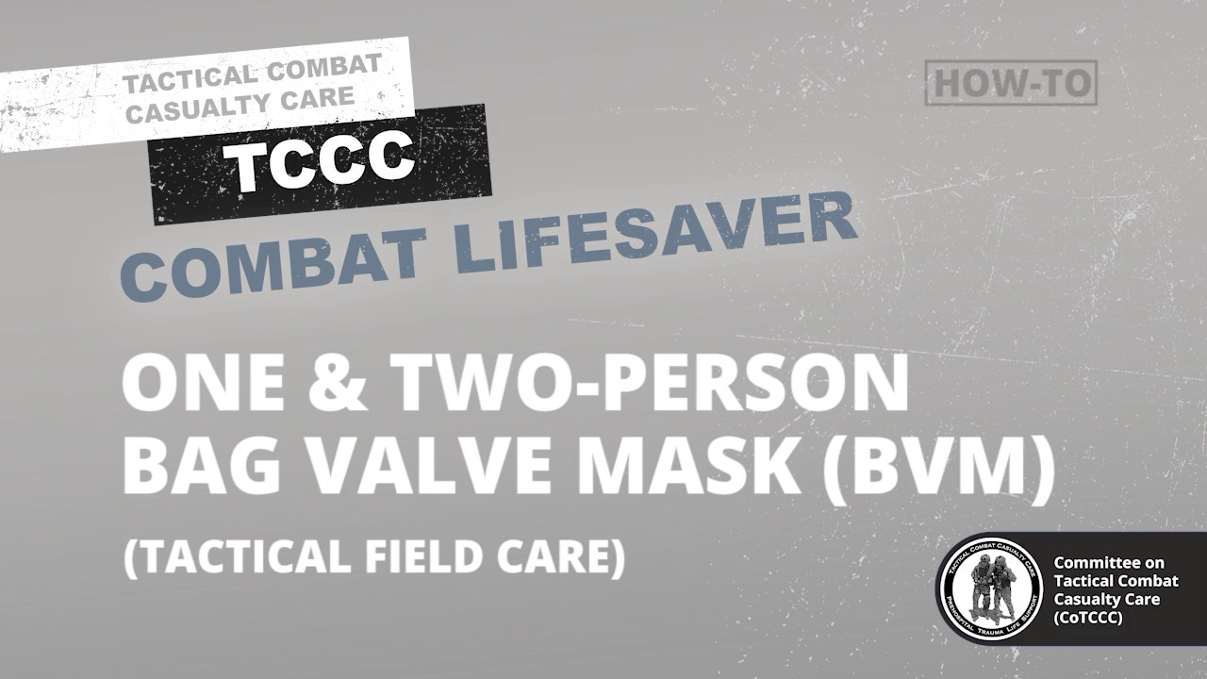
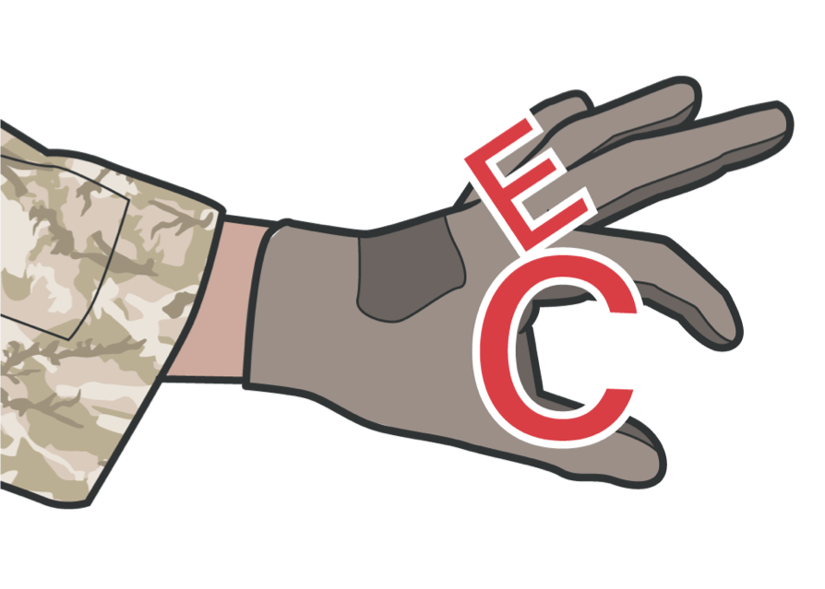
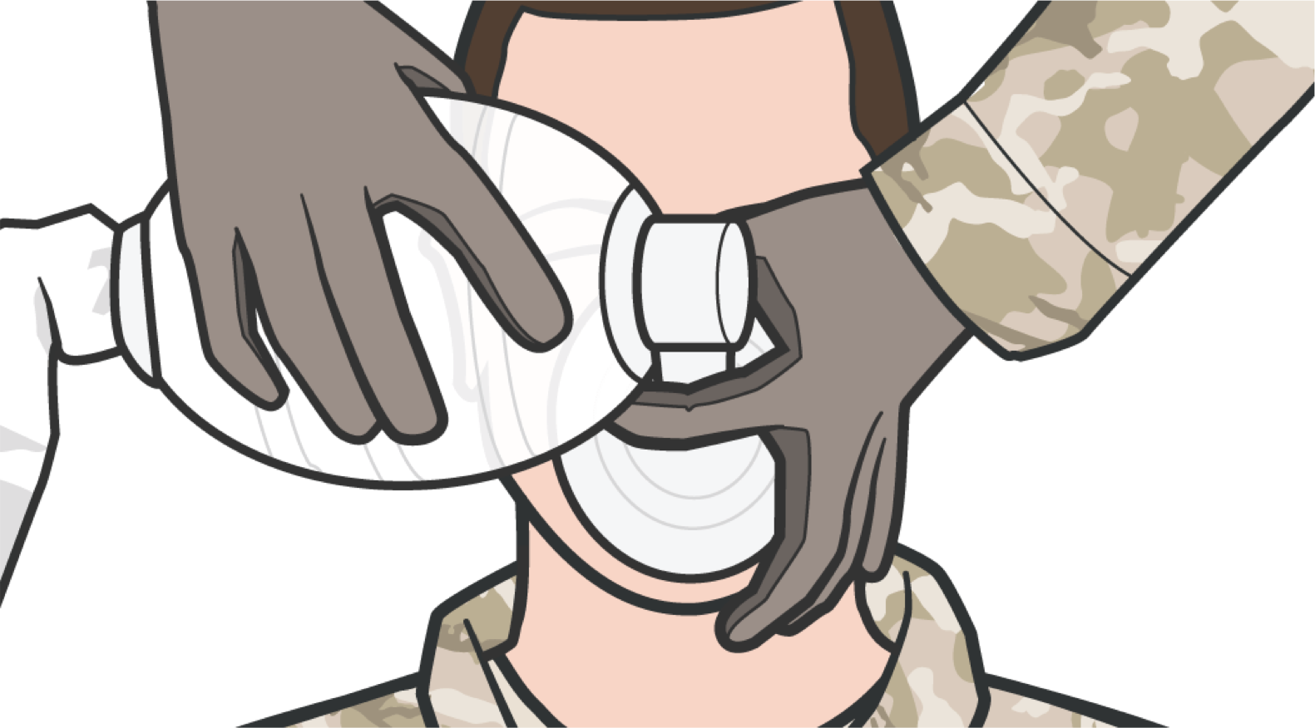
BAG VALVE MASK (BVM)
MANAGING THE AIRWAY
Video can be found on DeployedMedicine.com
One- and Two-Person BVM Video
Ventilations can be performed alone or with two people working together
The mask is sealed over the casualty’s mouth so that air
doesn’t escape
Squeeze firmly for 1-2 seconds and 5-6 seconds apart
M A R C H

Slide 16
MANAGING THE AIRWAY
BAG VALVE MASK (BVM)

Slide 17
SKILL STATION
Airway (Skills) Recovery Position
Nasopharyngeal Airway (NPA)
One-Person Bag Valve Mask (BVM)/Two-Person BVM

Slide 18
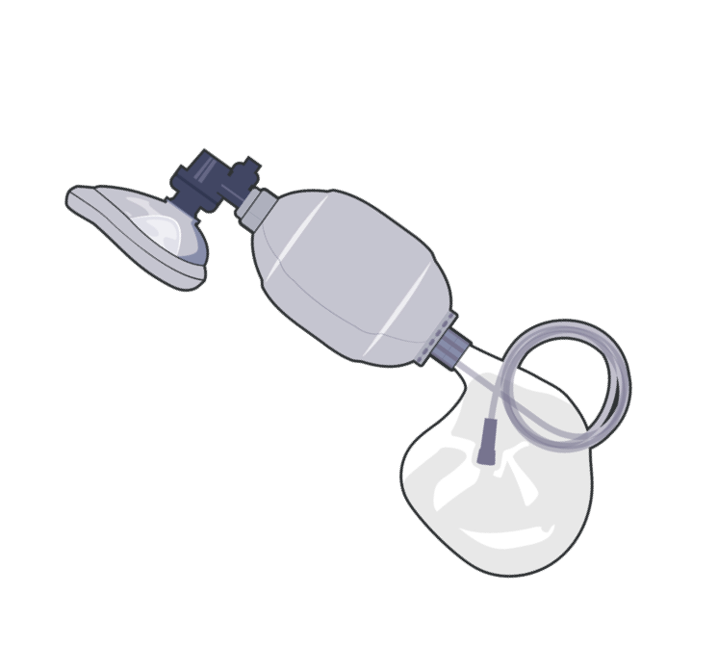
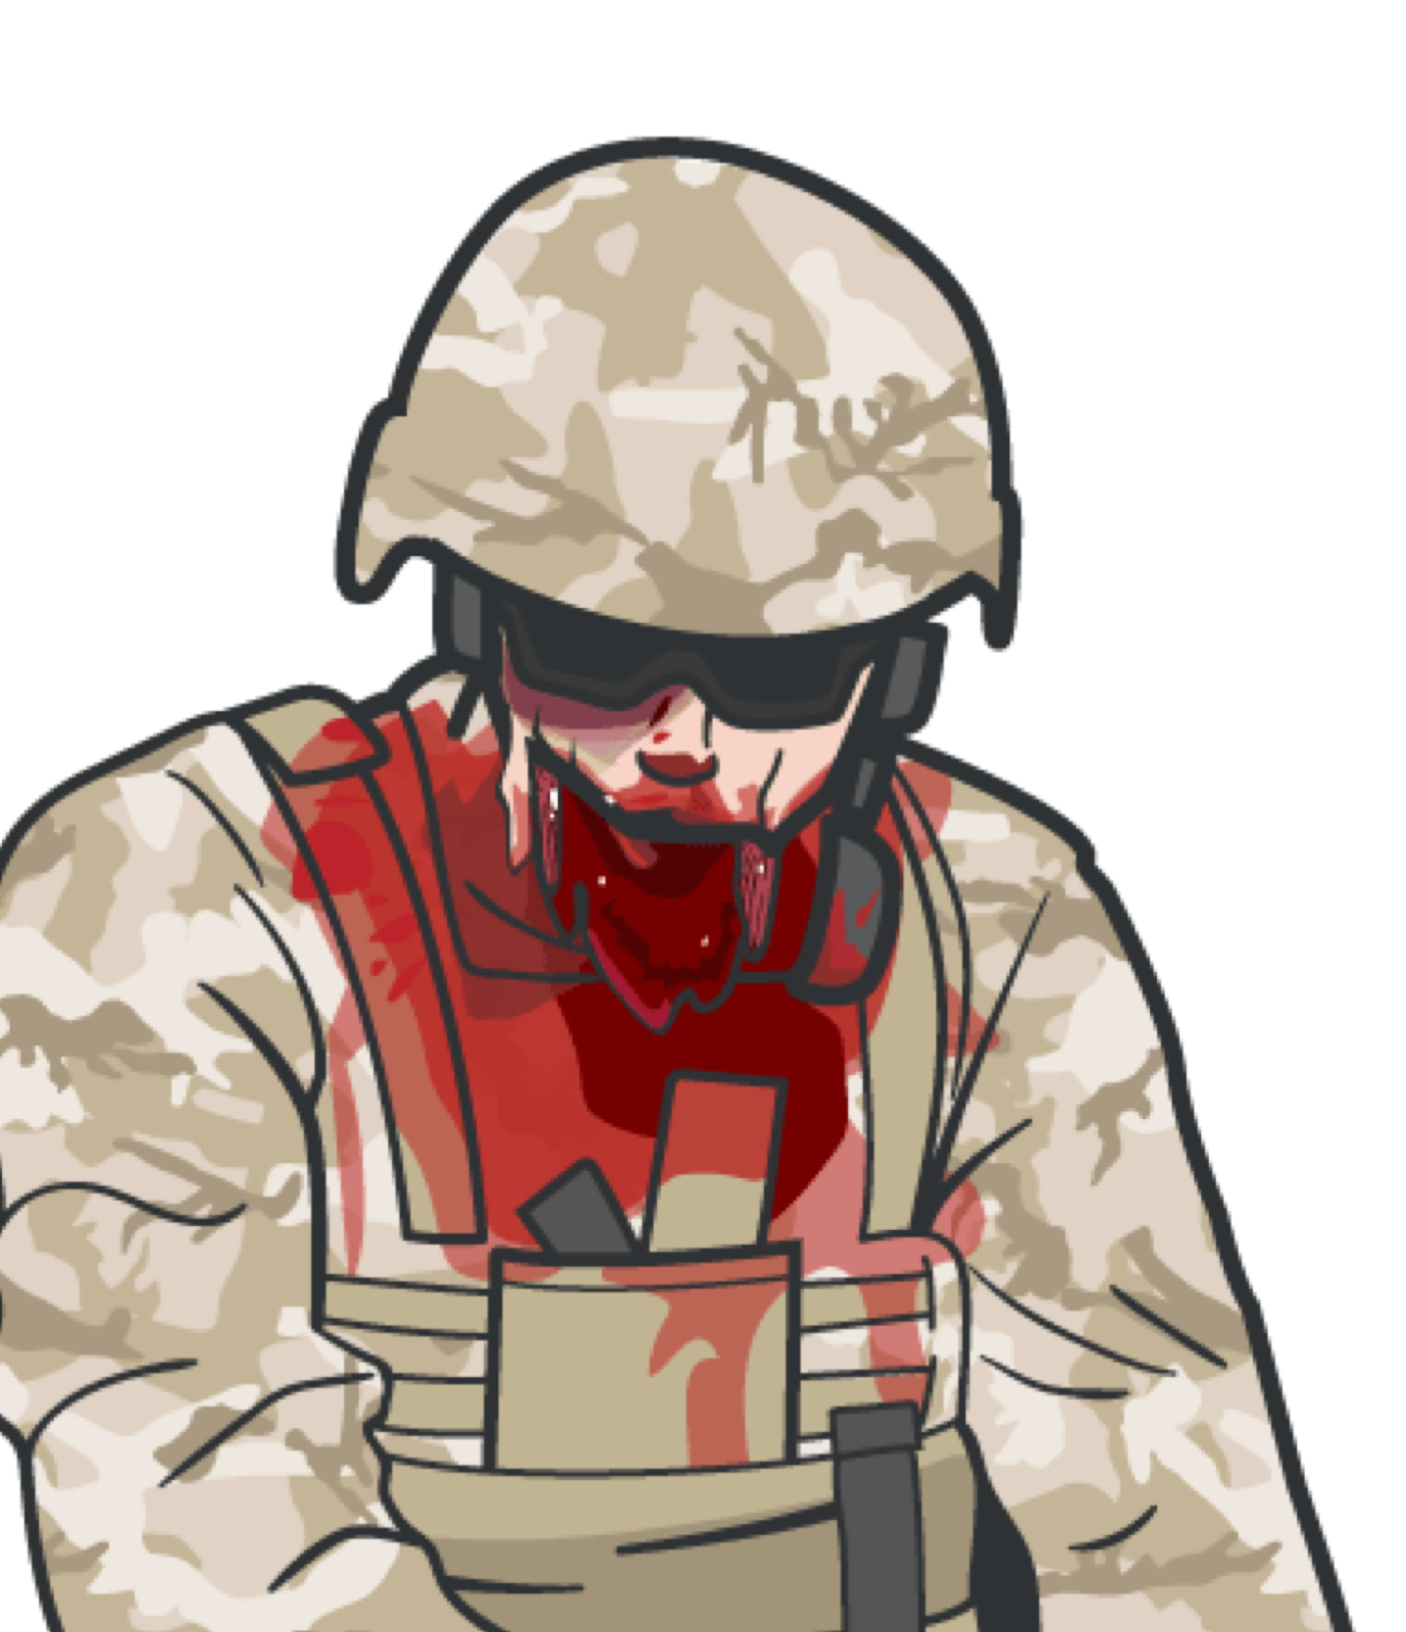
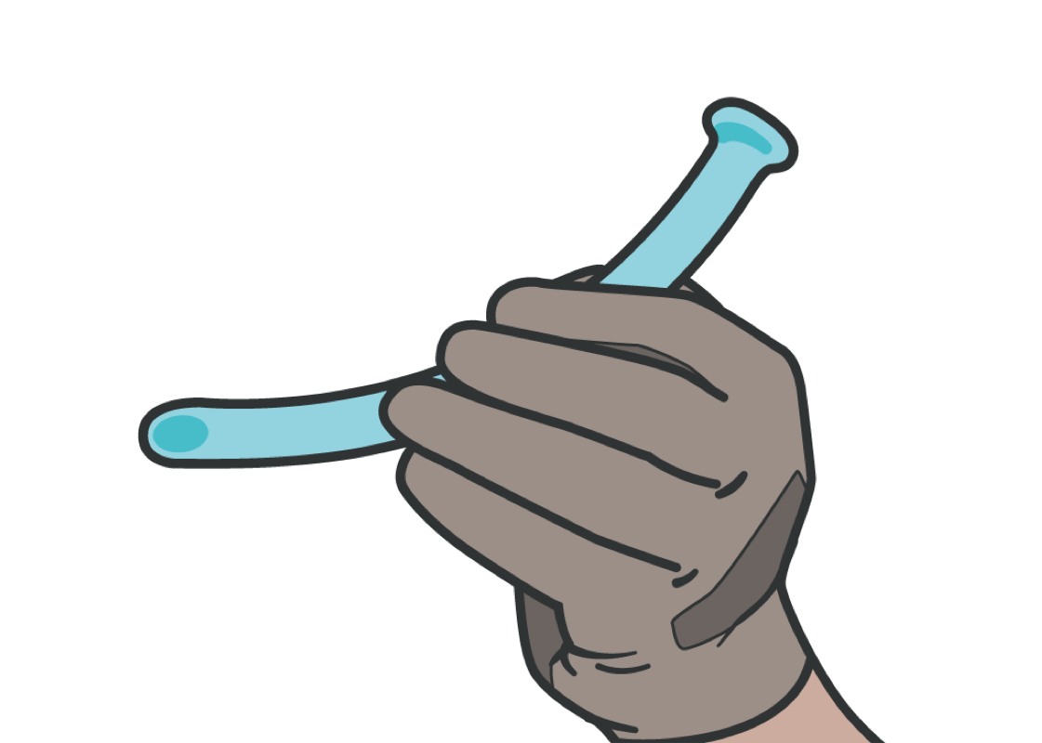
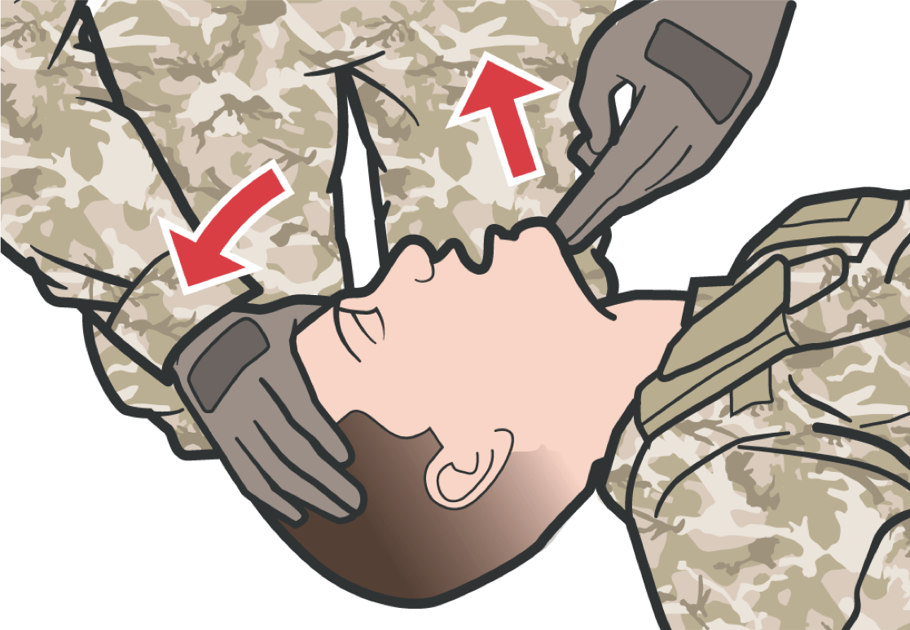
SUMMARY
We identified
We opened
We maintained and managed
For casualties in which airway positioning and/or nasopharyngeal airways DO NOT successfully maintain an open airway, notify medical personnel IMMEDIATELY

Slide 19
CHECK ON LEARNING
What is the best position for a conscious casualty who is breathing on their own? Why are casualties placed in the recovery position?
What are the two methods that can be used to open an airway? How does an NPA provide an open (patent) airway?

Slide 20
ANY QUESTIONS?

